Slide 1
Background & Research Progress
Jul 19, 2018
Xingyu Su

Slide 2
Self-introduction
Name: Xingyu Su (“苏星宇” in Chinese)
Email:
suxy15tsinghua@gmail.com
suxy15@mails.tsinghua.edu.cn
Phone:
1 (919) 638 2702
Website: suxy.info
Education: 2015-present in Tsinghua University
Undergraduate in Department of Energy and Power Engineering
Minor in Computer Technology and Application
Notes:
Here are some basic information of me and you can see more at my personal site: suxy.info

Slide 3
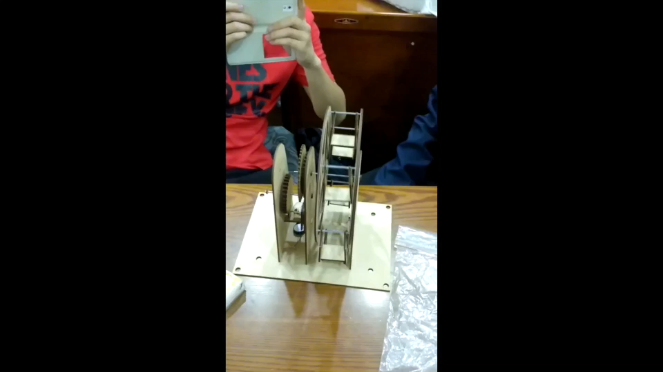
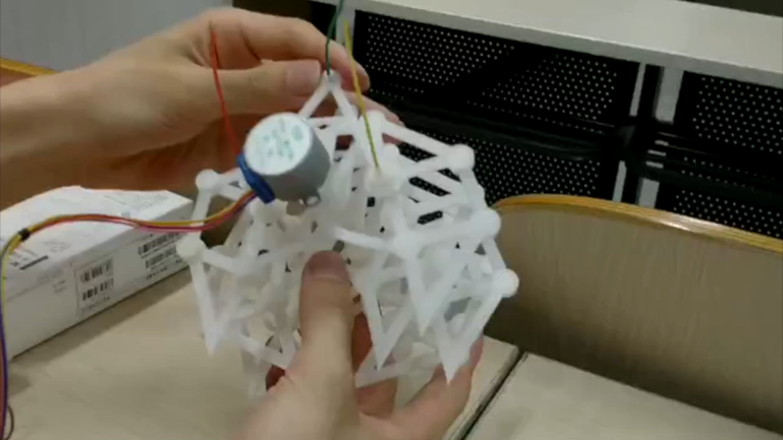
3D printing, Laser cutting
Notes:
I admire the spirit of geeks and dream of becoming a true geek.
The two are simple projects of 3D printing and laser cutting.

Slide 4
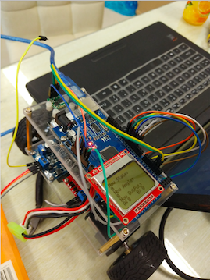
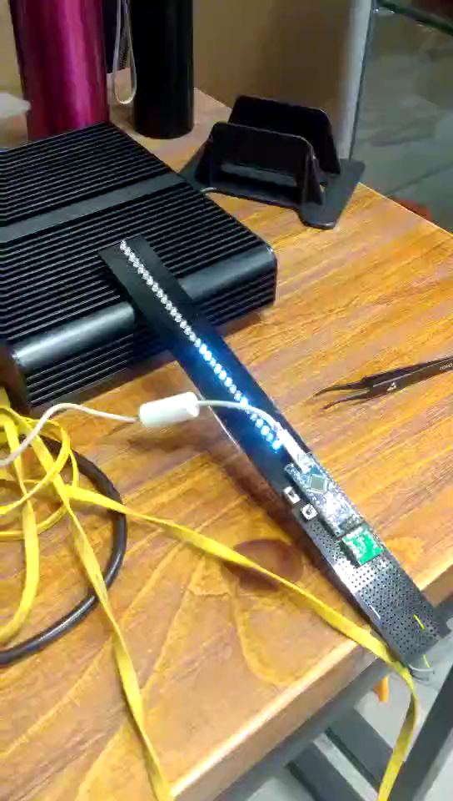
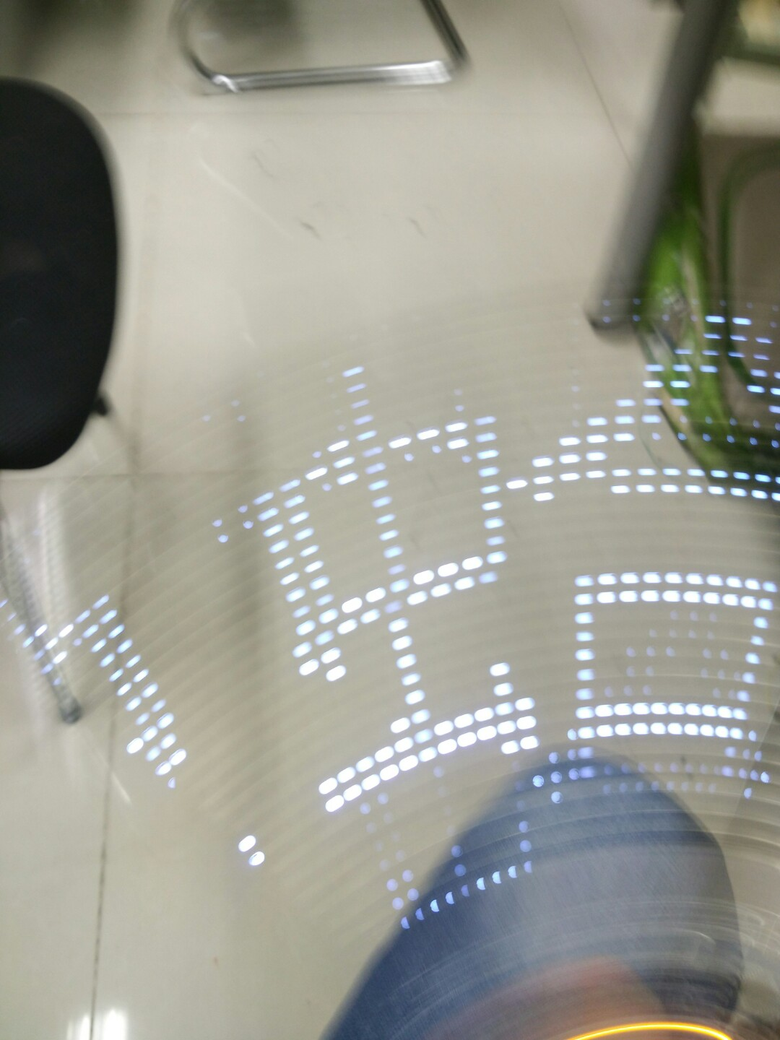
Self-balance scooter, POV display
POV: Persistence Of Vision
Notes:
And I have some hardware using experience, such as arduino, single chip microcomputer and raspberry pi.

Slide 5
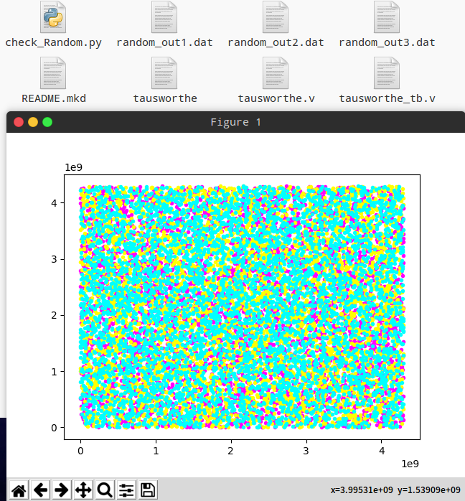
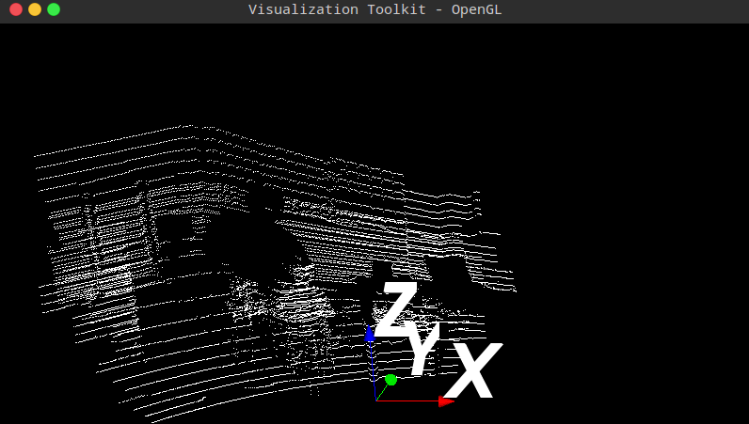
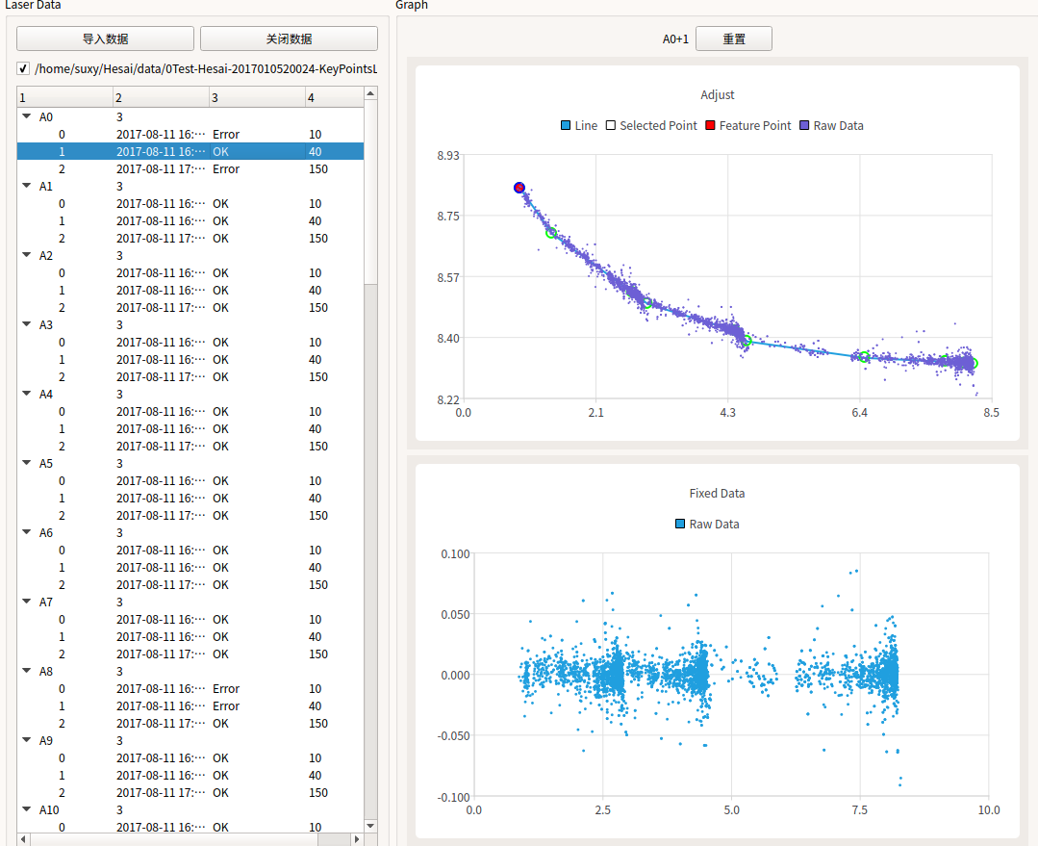
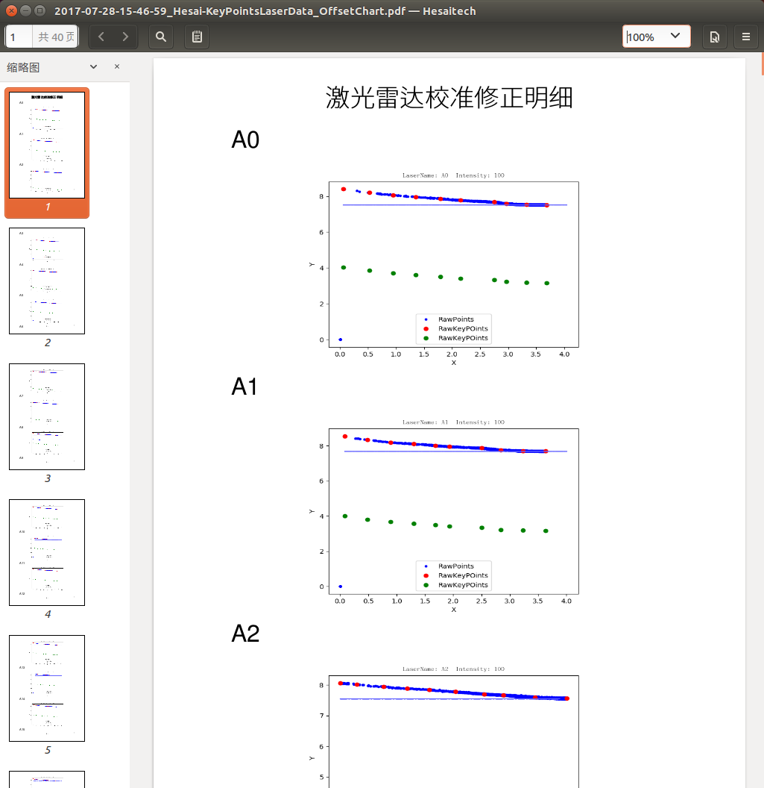
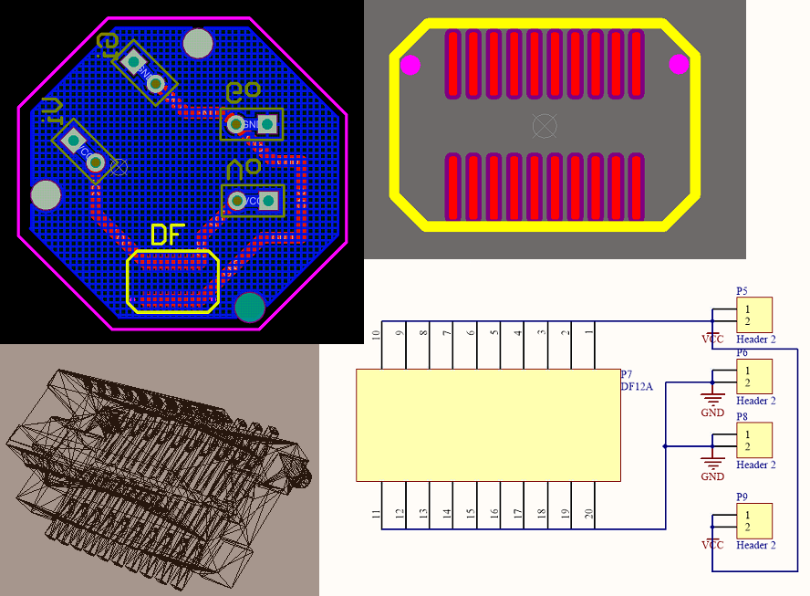
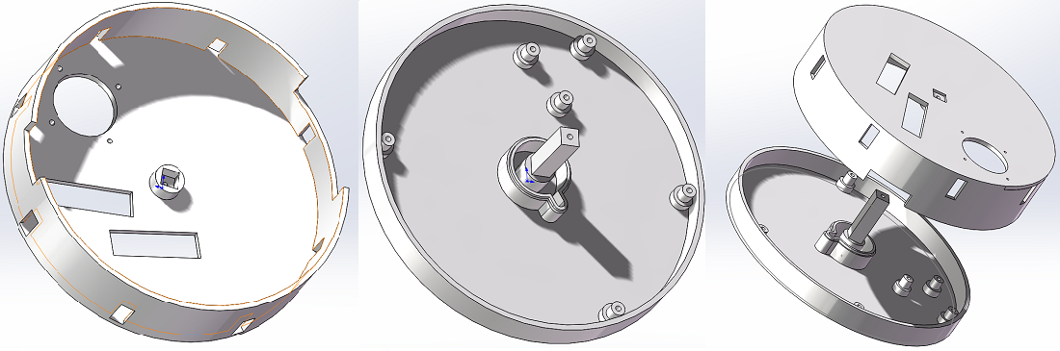
2017 Intern @Hesai Photonics Technology
Notes:
Last summer I worked as an intern in a start-up company in Shanghai, and learned a lot of skills.
Lidar Calibration by Python+Qt
Power adapter board by Altium Designer
Document generator by Python
FPGA Random Generator by Verilog
3D Point cloud Visualization by Python+VTK
Testing Container by Solidworks

Slide 6
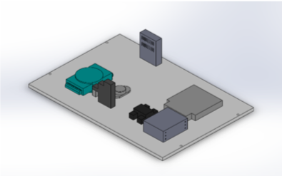
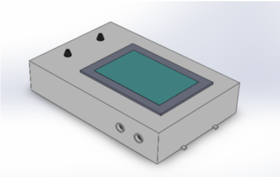
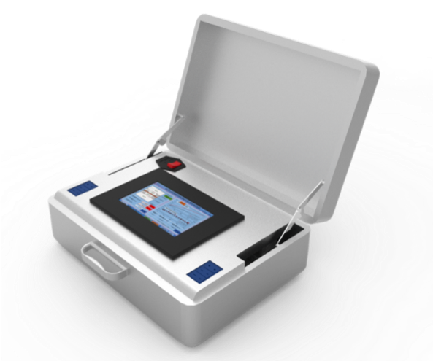
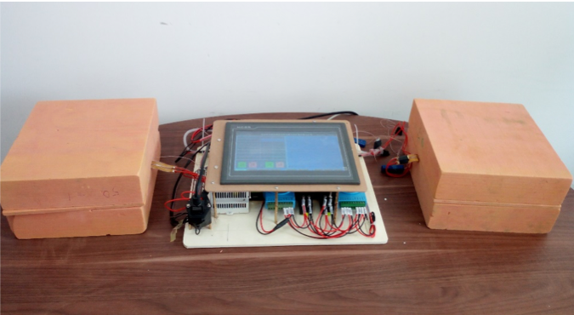
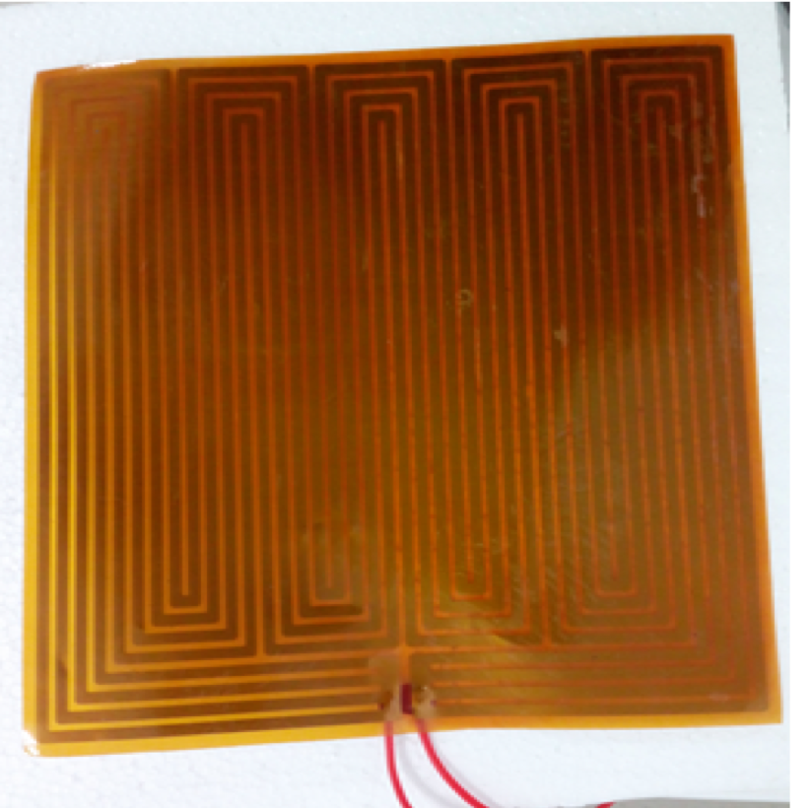
Portable construction material thermal property measuring instrument
Notes:
And here is my first research project.
It’s an experiment equipment and my part was to do experiment and analysis data.

Slide 7
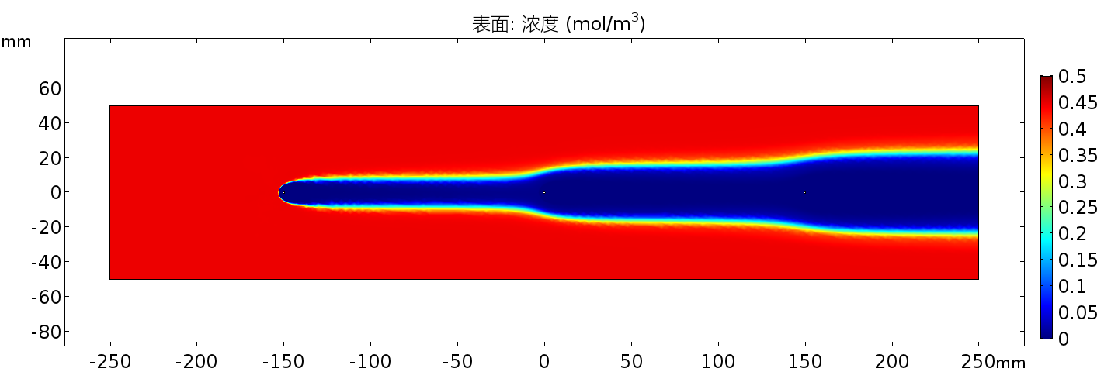
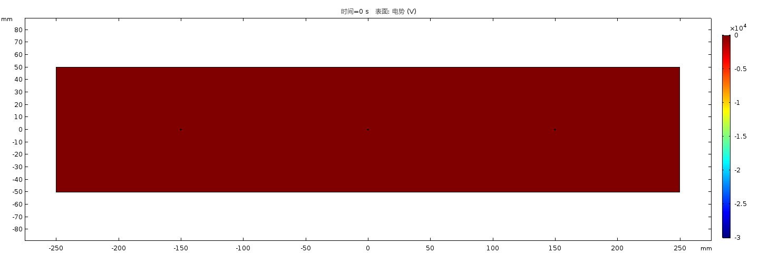
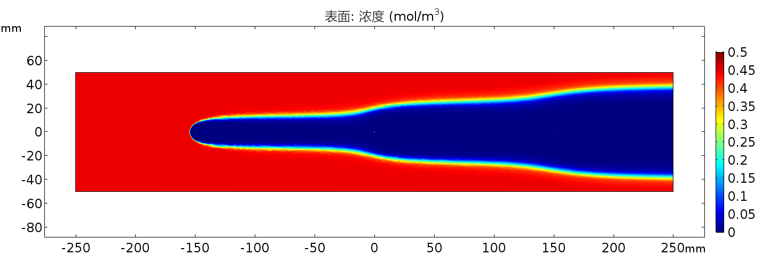
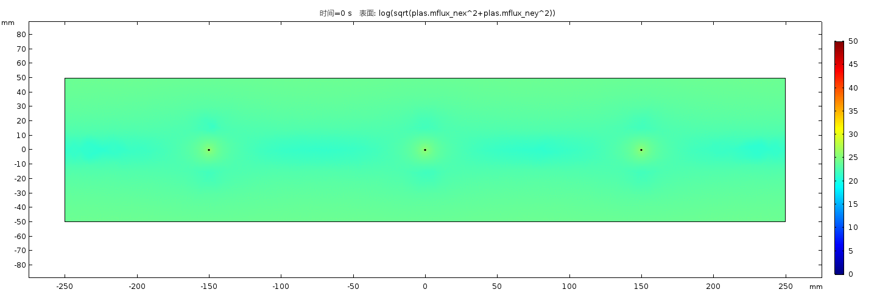
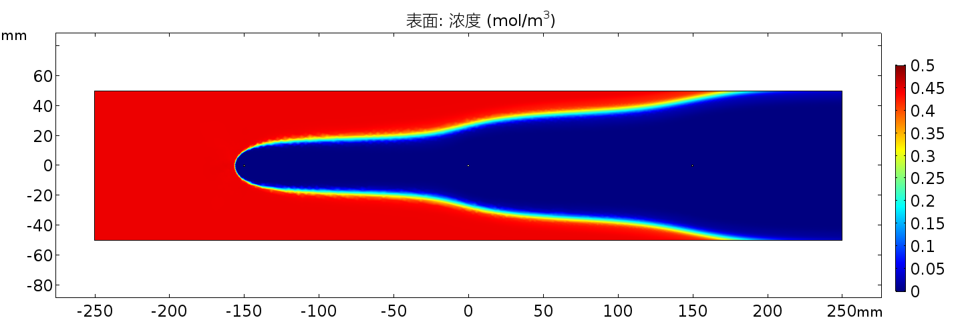

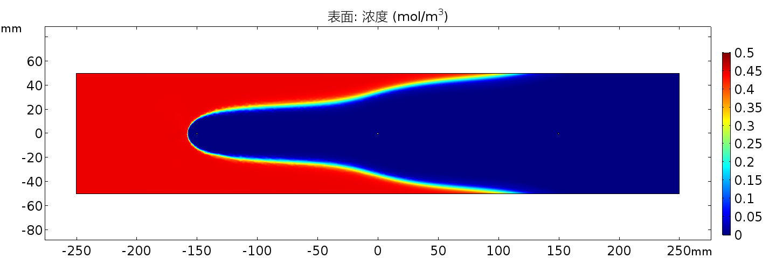
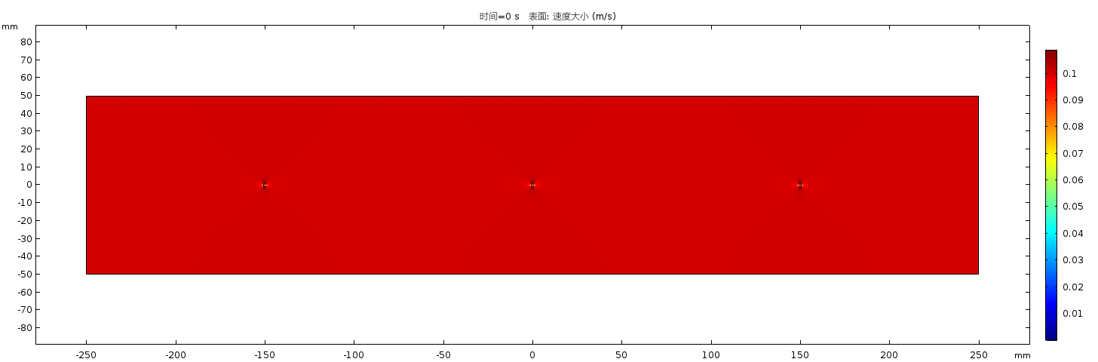
Simulation of electrostatic precipitators
Notes:
This was a simulation project by COMSOL.

Slide 8
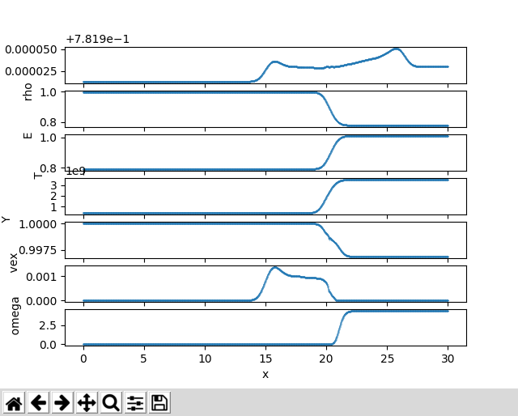
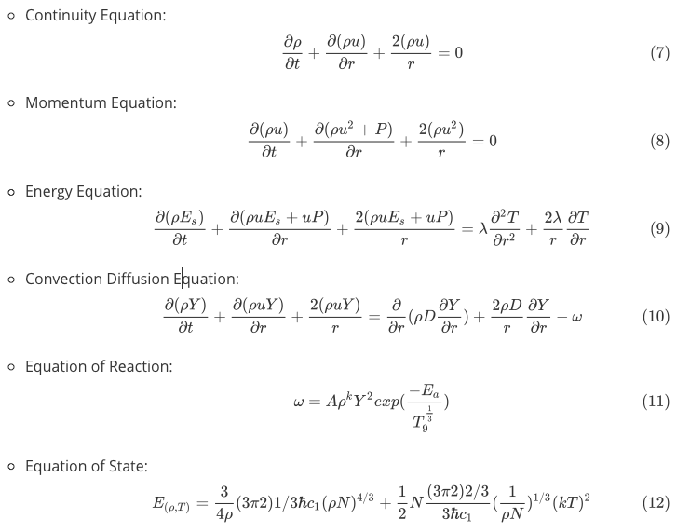
Simulation of spherical inward propagating Carbon-Oxygen flame (IPF) of type Ia supernova
Notes:
This is a project that I am still working on.
Simulate by Fortran & CPP

Slide 9
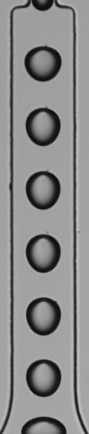




iOS Droplet Counter
original
background
reverse
add
binarize

Slide 10

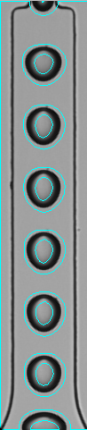

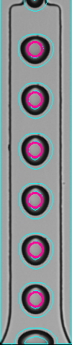

iOS Droplet Counter
morphology
contour
recognize
segments
average

Slide 11
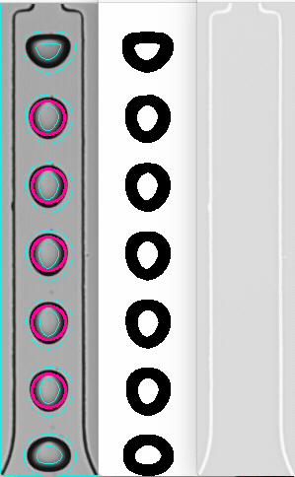
iOS Droplet Counter
Useful Demo
Background subtraction
Morphology operation
Contour generation
Shape and size recognition
Droplet segmentation

Slide 12
Next Week Plan
Moving the C++ to iOS Swift & Objective C
Confirm computer of camera SDK
Moving the python demo to C++ or Matlab for camera
Algorithm improving

